Slide 1
Problem Setting
Big Mountain Resort is one of the largest ski resorts in Montana and offers skiing and snowboarding facilities.
We are located next to Glacier National Park and Flathead National Park and hosts about 350,000 visitors every year.
We have recently installed a new chairlift that has driven up our operating cost by more than $1.5M.
We want to increase our profit by implementing a data-driven strategy:
  Determines were we stand compared to other national resorts on the premium facilities that we offer our visitors.
  Verify that our visitors will be willing to pay more for those services.
  Establish by how much the ticket price can be increased.
  Identify areas where operational cost can be reduced.

Slide 2
Key Findings and Recommendation
The ticket price can be incremented by up to $14.87 which means that the revenue can go up by about $5.2M
We need to increment the ticket price by just $0.88 to offset the increase new chairlift operational cost
We can close our least used run and reduce our operational cost without affecting our revenue in any way
Adding a run, increasing the vertical drop a little and installing an additional chairlift, we can increase the ticket price by $1.99 and the revenue by almost $3.5M

Slide 3
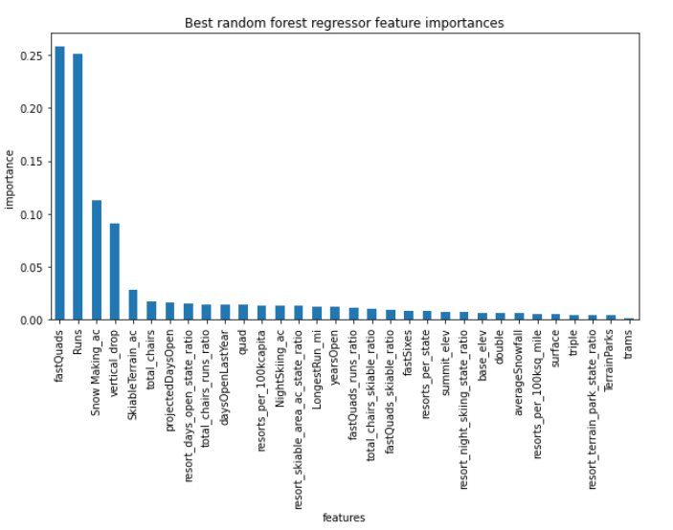
Modeling Results and Analysis
This figure depicts the best features by importance that predict resort ticket prices.
According to our model, some of the best features are:
  Fast Quads
  Runs
  Snow Making Area Covered
  Vertical Drop
  Skiable Terrain Area
  Total Chairs

Slide 4
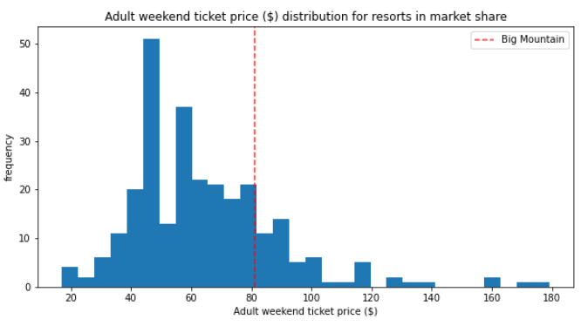
Modeling Results and Analysis
Current ticket price is $81, which lies at about 81st percentile of all other ski resorts in the country.
Our model suggests that the price should be $95.47.

Slide 5
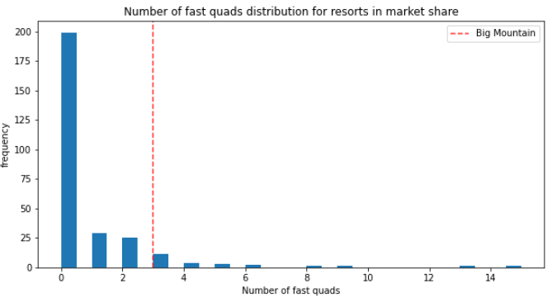
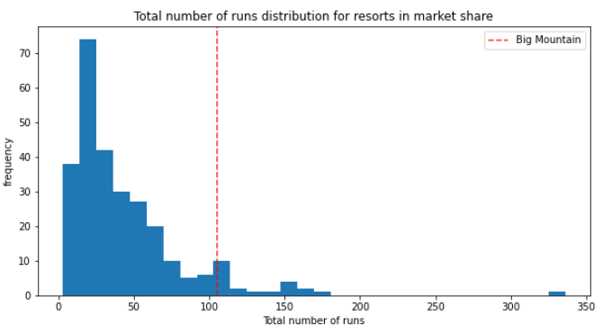
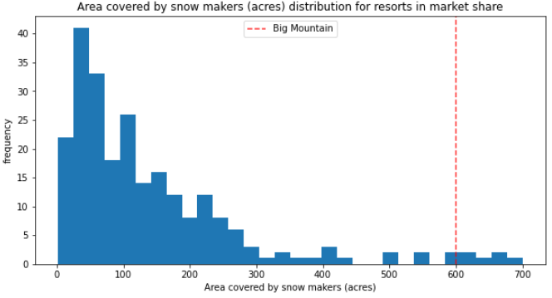
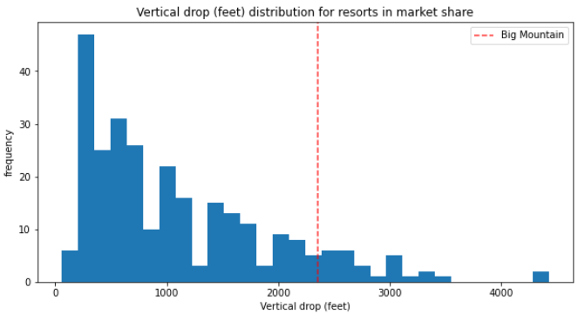
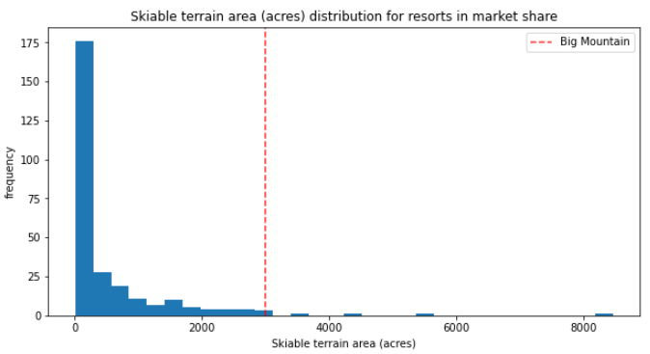
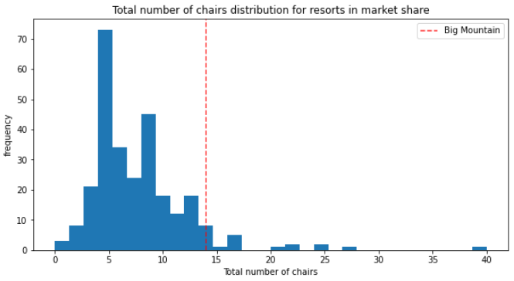
Modeling Results and Analysis
How we fare in terms of facilities offered to our visitors
Fast Quads ~ 90th percentile
Runs ~ 93rd percentile
Snow Making Area Covered ~ 97th percentile
Vertical Drop ~ 89th percentile
Skiable Terrain ~ 98th percentile
Total Chairs ~ 95th percentile

Slide 6
Summary and Conclusion
We can increase our ticket price from to $95.87 to $85.48. With an error margin of 10.39, we can safely increase it to at least $85.48 which will increase our revenue by close to $1.6M
We can safely close out least used run and save on our operational costs without reducing our revenue
We can potentially increase our revenue by $3.5M by adding a run, increasing the vertical drop by 150ft and installing an additional chairlift. This however needs further investigation of the operating cost involved.

